Slide 1
CSL 554 Text and Web Intelligence Analytics
Anjali Goyal (anjaligoyal@ncuindia.edu)
Lecture 2 – 26th July 2018 (Thursday 08:30 AM – 09:20 AM)

Slide 2
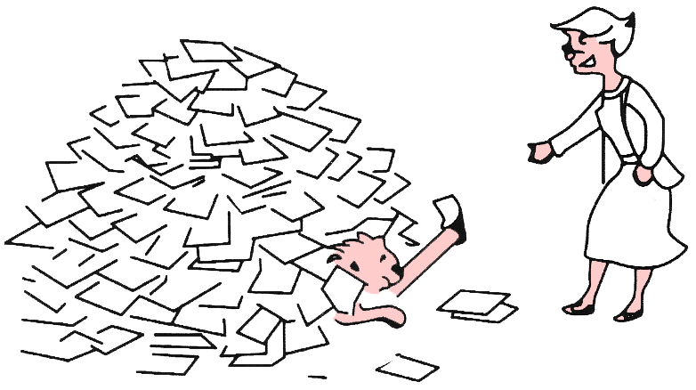
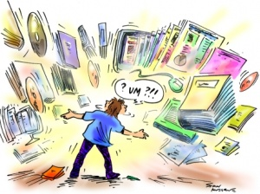
Information Overload
“It refers to the difficulty a person can have understanding an issue and making decisions that can be caused by the presence of too much information.” - wiki

Slide 3
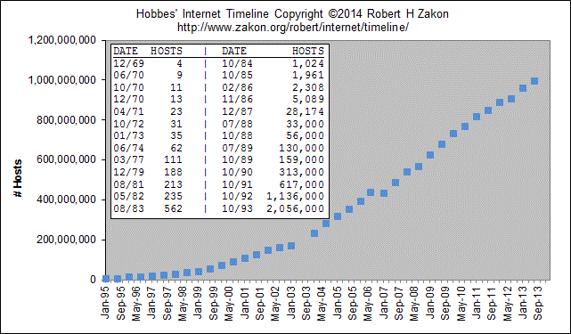
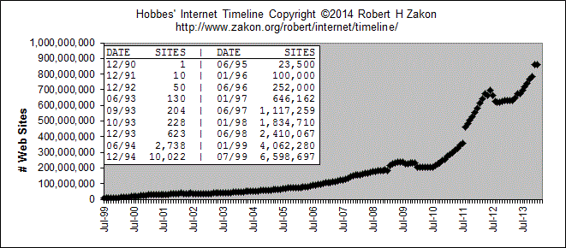
Information Overload
Figure 2: Growth of WWW
Figure 1: Growth of Internet

Slide 4
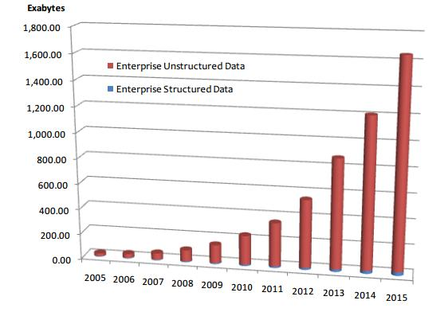
Information Handling
Handling unstructured data
Structured data: database system is a good choice
Unstructured data is more dominant
Text in Web documents or emails, image, audio, video…
“85 percent of all business information exists as unstructured data” - Merrill Lynch
Unknown semantic meaning
Table 1: People in CS Department
ID | Name | Job
1 | Jack | Professor
3 | David | Stuff
5 | Tony | IT support
Total Enterprise Data Growth 2005-2015, IDC 2012

Slide 5
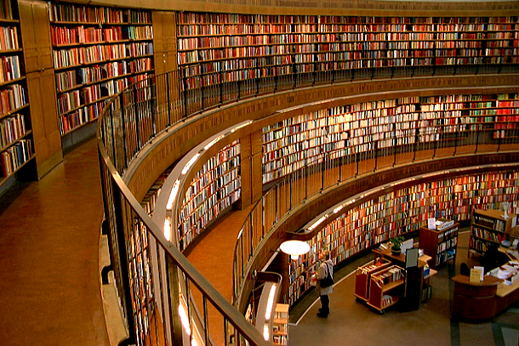
Current Scenario
You are here!

Slide 6
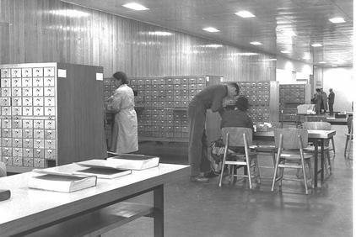
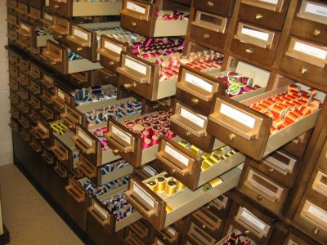
How to perform information retrieval
Information retrieval when we did not have a computer

Slide 7
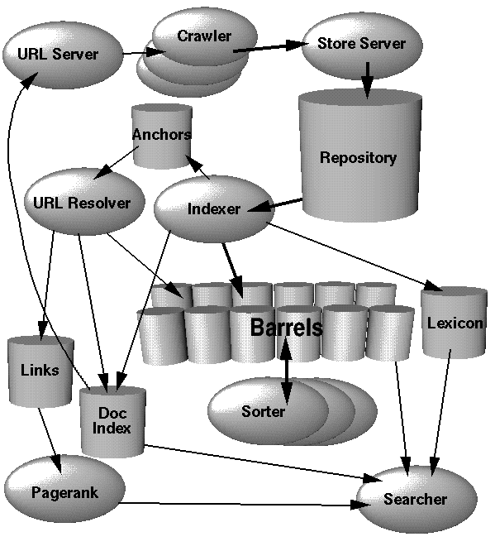
How to perform information retrieval
Crawler and indexer
Query parser
Ranking model
Document Analyzer

Slide 8
Text Analytics
Text Analytics, also known as text mining, is the process of examining large collections of written resources to generate new information, and to transform the unstructured text into structured data for use in further analysis.
Text mining identifies facts, relationships and assertions that would otherwise remain buried in the mass of textual big data.
These facts are extracted and turned into structured data, for analysis, visualization (e.g. via html tables, mind maps, charts), integration with structured data in databases or warehouses, and further refinement using machine learning (ML) systems.

Slide 9

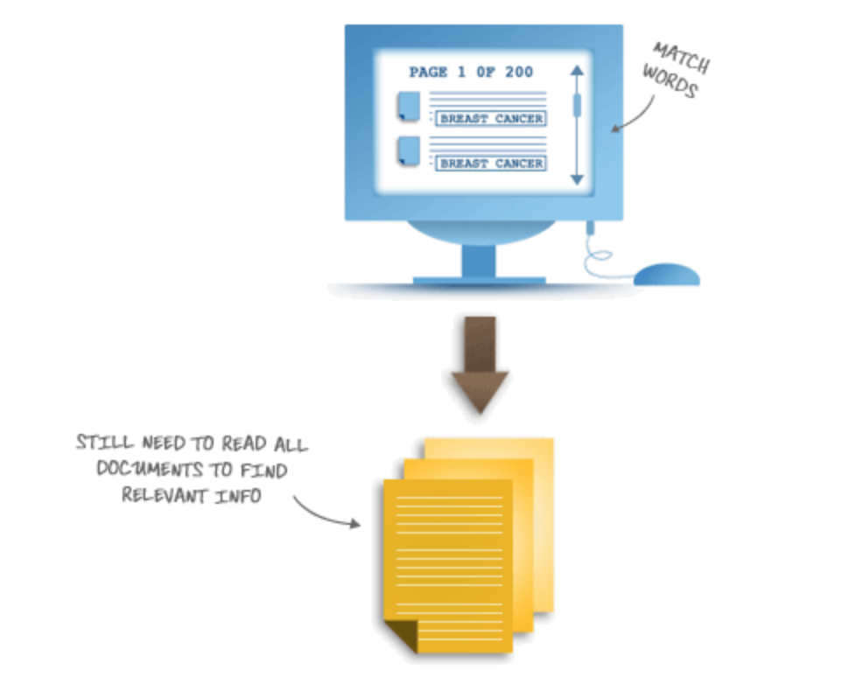
Text Mining vs Traditional Keyword Search
Traditional Search
Traditional keyword search retrieves all the documents that contain
the keywords you’ve specified.

Slide 10
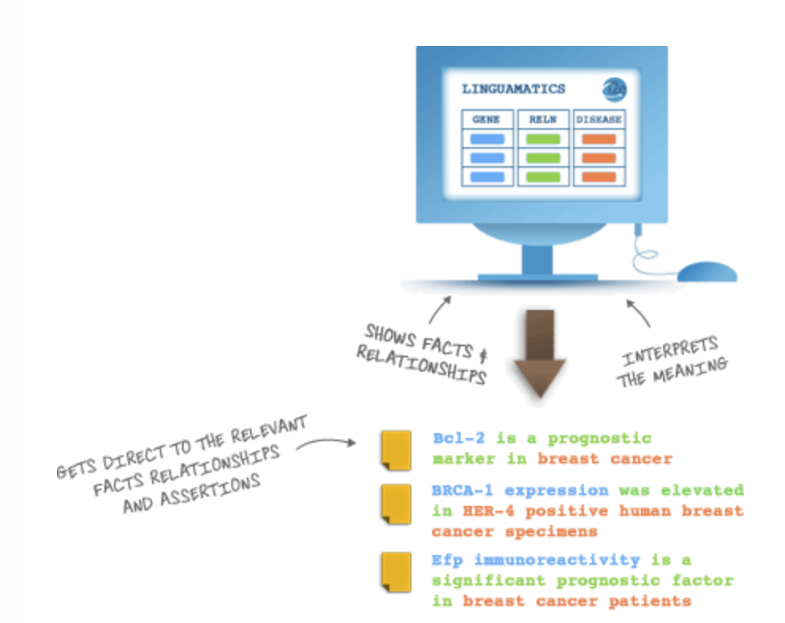
Text Mining vs Traditional Keyword Search
Text Mining
Text Mining reads and analyzes the documents on your behalf.
Makes use of NLP, recognize similar concepts and then produces results.

Slide 11
NLP
Natural Language Processing allows the software to recognize similar concepts – even if they’ve been expressed in very different ways.
For example,
Same word spelt differently (hemophilia/haemophilia, tumor/tumour),
Same word different contexts (tumor/tumors, suffers/suffered),
Same concept different words (Tylenol/Acetaminophen, heart attack/ myocardial infarction),
Same concept different grammatical constructions (“he has not smoked for 5 years”/ “he stopped smoking 5 years ago”).

Slide 12
Basic assumptions in Mining
Sec. 1.1
Collection: Fixed set of documents
Goal: Retrieve documents with information that is relevant to the user’s information need and helps the user complete a task

Slide 13
Unstructured data in 1620
Sec. 1.1
Which plays of Shakespeare contain the words Brutus AND Caesar but NOT Calpurnia?
One could grep all of Shakespeare’s plays for Brutus and Caesar, then strip out lines containing Calpurnia?
Why is that not the answer?
Slow (for large corpora)
NOT Calpurnia is non-trivial
Other operations (e.g., find the word Romans near countrymen) not feasible
Ranked retrieval (best documents to return)
Notes:
Grep is line-oriented; IR is document oriented.

Slide 14
Term-document incidence
Sec. 1.1
1 if play contains word, 0 otherwise
Brutus AND Caesar BUT NOT Calpurnia

Slide 15
Incidence vectors
Sec. 1.1
So we have a 0/1 vector for each term.
To answer query: take the vectors for Brutus, Caesar and Calpurnia (complemented) ➔ bitwise AND.
110100 AND 110111 AND 101111 = 100100.

Slide 16

Thank You

